Slide 1

Emulation and Sensitivity Analysis of the CMAQ Model During a UK Ozone Pollution Episode
Andrew Beddows
Environmental Research Group
King’s College London
Notes:
I’m going to talk about the statistical emulation of CMAQ in order to allow detailed sensitivity analysis, which I’ve done for a pollution episode which occurred during the summer of 2006.
The results are very specific to this particular domain, however, so first I’m going to talk about the methods, and then use this particular episode to illustrate the kind of results which they can produce.

Slide 2
Rationale – Why emulate CMAQ?
Sensitivity analysis of complex models like CMAQ is usually carried out on an ad-hoc basis, changing one input at a time.
A more rigorous approach involves perturbing all of the inputs at once and decomposing the variance this induces in the output into contributions from each input.
This requires thousands or even millions of runs so is prohibitive for models with long run times.
  The same is true for Monte Carlo uncertainty analysis.
The solution is to build an ‘emulator’ – a statistical metamodel of the atmospheric model.
This can be used in place of the model in a variety of sensitivity and uncertainty analysis techniques.
Notes:
When I talk about emulating CMAQ I’m talking about making a model of a model – so, why do we want to do it?
Sensitivity analysis of complex models like CMAQ is often carried out on a ad-hoc basis, changing one input at a time. Now, that may be what you actually want to do, to look at a particular change in an emissions scenario, for example, or it may be what you do because its all you have the computing power to do.
A more rigorous approach to sensitivity analysis involves perturbing all of the inputs at once and decomposing the variance this induces in the output into contributions from each of the inputs.
This however, requires thousands or even millions of model runs and so is prohibitive for models like CMAQ with long run times. The same is also true for Monte Carlo uncertainty analysis.
The solution is to build an emulator – a statistical metamodel of your atmospheric model – which can be used in place of the original model in a variety of sensitivity and uncertainty analysis techniques.

Slide 3
Input Variable Screening
For models with hundreds of input variables it is first helpful to identify the subset which most influence the output of interest before building an emulator.
In this case 224 input variables from emissions, boundary conditions and reaction rates were screened to test their influence on ozone and NO₂ output.
Morris’ OAT method⁽¹⁾ was used for this purpose
  Input variables are perturbed one at a time giving a corresponding response in the model output termed an `elementary effect’.
  This is repeated a number of times with the other variables in different positions each time.
Notes:
Before we set about emulating the model its useful to reduce the number of input variables we’re dealing with. Its common for models with lots of inputs to only have a subset which are active with regards to any particular output so we want to indentify that subset before we build our emulator.
In this case I started with 224 input variables from the emissions input files, the model boundary conditions and reaction rates from the CB-5 core chemical mechanism, and I wanted to screen them to measure their influence on the modelled concentrations of ozone and NO2.
For this I used Morris’ one at a time method, in which, as the name suggests the input variables are perturbed one at a time giving a response in the model output which we call an elementary effect.
This is repeated a number of times over a different portion of that particular variables range of variability and with the other variables fixed, but fixed at different values on each occasion, and this creates a number of elementary effects for each input variable.

Slide 4
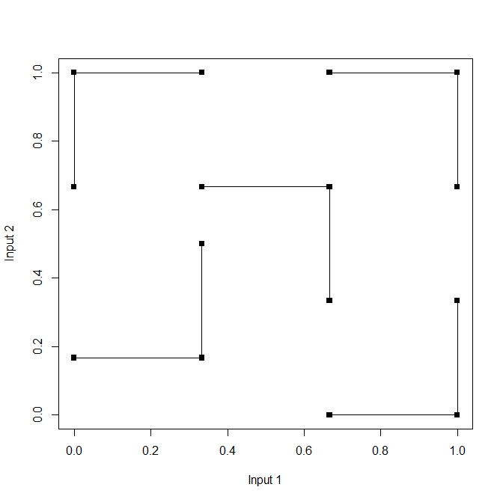
To achieve this with the fewest model runs step along the axes of the input variable space.
Notes:
So if we imagine a model which only had two inputs, just for the sake of being able to show it easily in a diagram, I’ve plotted the inputs against each other, and we’ll refer to this as the input variable space, and each black dot represents a model run. you can see how stepping along the axes allows us to make five elementary effects per variable in this case with the least number of model runs.

Slide 5
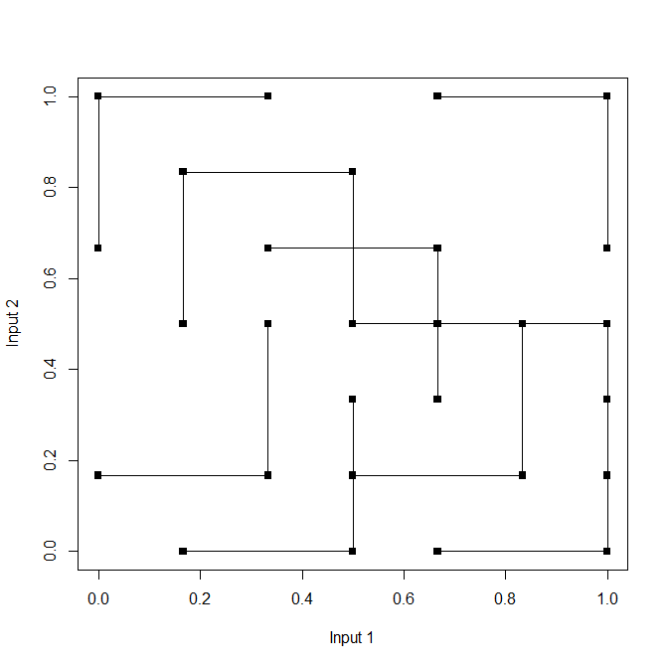
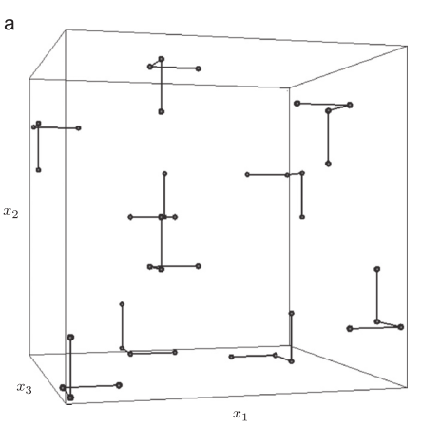
Notes:
If we continue to add more of these little trajectories we start to fill up the space but we can see that that’s not happening very evenly, so what we would do in practice is to generate a large number of these sets of trajectories and pick the one with the largest total distance between the points.
The picture on the right shows the same thing in a 3 dimensional variable space, again showing how stepping along the axes is the most efficient way to generate the elementary effects, with each trajectory taking four model runs to generate three elementary effects as opposed to six runs if each one were done independently.

Slide 6
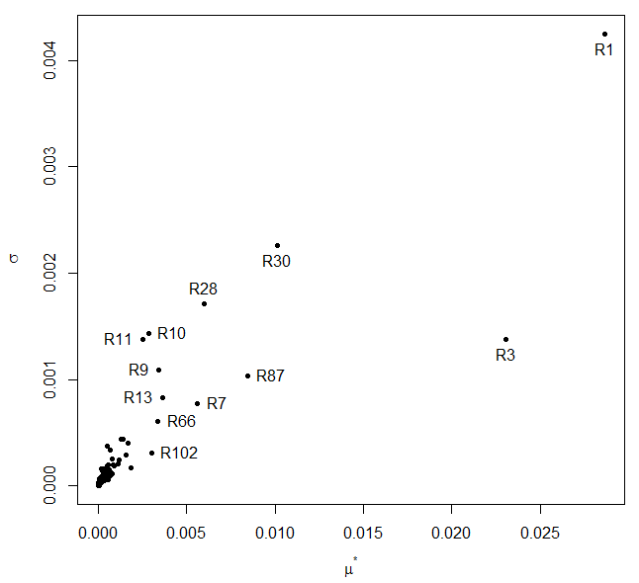
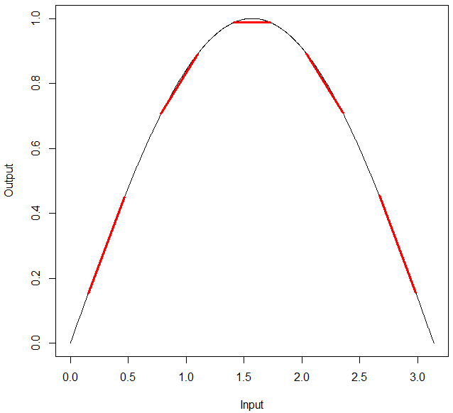
Ranking the mean of the absolute values of the elementary effects for each model input provides a way of ranking the inputs in order of importance.
Plotting the mean of the model output responses for each input against their standard deviations indicates non-linear or non-monotonic model output
Notes:
In order to assess the importance of a particular variable we calculate the mean of the absolute values of its elementary effects, and then we can rank the variables to allow us to select a subset to carry forward for further analysis.
The reason we use the absolute values of the elementary effects is illustrated by this rather extreme example on the right, where we can see five elementary effects in red, and the mean of those gradients is clearly zero even though this would be quite an important input.
Just as an aside, the graph on the left shows how this method can be used as a useful sensitivity analysis method in its own right, if we plot the standard deviation of the elementary effects against their means.
An input with an important, but linear effect would have a high mean but a low standard deviation whereas an important input with a non-linear effect would have both a high mean and standard deviation and so on.

Slide 7
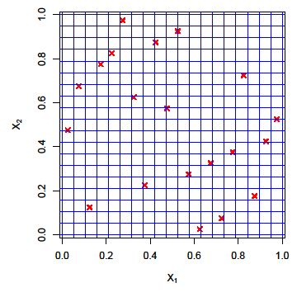
Building the Emulator
31 variables have been retained after the screening process.
Emulate the model output over ranges of one-half to double the base case value of each variable
Training runs must be performed which fill the 31 dimensional space.
A Latin hypercube⁽²⁾ design was used for this purpose.
A variety of space filling designs can be used – the important points are that they fill the input variable space efficiently and that there are no correlations between the inputs.
Notes:
So after the screening process I’ve been left with 31 variables which have a significant effect on the model output, and I want to emulate that output over ranges of one half to double the base case value. That’s an arbitrary decision, but if your building an emulator to use in an uncertainty analysis you just want to make sure that you’ve used a range large enough to cover whatever uncertainty distributions your inputs are going to have.
You then need to perform some CMAQ runs to provide training data for your emulator, and these need to evenly cover the input variable space, and you want to make 10 or more runs per input variable.
To decide on the input values for those runs I’ve used a Latin hypercube design an example of which is shown here, again in two dimensions. The axes are divided up into the same number of intervals as the number of runs, and the points are placed so that there is one, but no more than one, in each row or column. This gives the maximum amount of information from a given number of runs.
There are a number of other designs you can use, but the important points are that the runs fil the space efficiently and there are no correlations between the inputs.

Slide 8
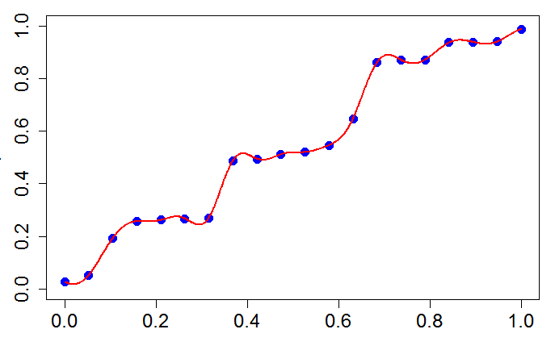
Gaussian Process Emulation⁽³⁾
Generalization of Kriging based methods to higher dimensions
The computer model output, Y(x), can be treated as the sum of a regression model and a random process, Z(x):
In contrast to other non-linear regression techniques the Gaussian process passes through the training data points exactly.
Ideal for modelling the output of deterministic computer models which produce the same output every time they are run with the same input values.
Output
Training run
Model input
Notes:
After we’ve performed our training runs we then build our statistical metamodel of CMAQ using Gaussian process emulation. If any of you are familiar with kriging methods in geostatistics, its essentially the same method generalized to a higher number of dimensions. So whereas you might use kriging to interpolate some property of the land surface over two or three dimensions, here we interpolate the model output over a space with the same number of dimensions as the number of model inputs.
The model output, Y, as a function of x, which is the vector of model inputs, is shown here with a capital letter Y because we treat the model output as if it were a random variable. It’s obviously not random in reality, but given that we don’t know what the model output corresponding to any particular set of inputs will be if we haven’t actually run the model at those input settings, it’s a useful mathematical device to treat it as if it were a random quantity.
So that means we can treat the model output as the sum of a regression model and a Gaussian random process, the regression model represents the overall trend in the output of the training runs, and the Gaussian process interpolates the residuals.
This makes the method ideal for modelling the output of deterministic computer models like CMAQ because if you run them twice with the same inputs they produce identical output, so there is no residual variability.

Slide 9
Relationship to Reduced Form Models
There are several examples of CMAQ RFMs in the literature.
Produced using Taylor series expansions of DDM sensitivity coefficients – requires much less effort than performing all of the training runs required to build an emulator.
  So why bother?
Emulators interpolate the training data whereas RFMs extrapolate, so emulators are inherently more accurate.
Emulators can explore the relationships between all variables rather than just selected pairs or groups of variables.
Should be thought of as complementary rather than competing methods
  Emulators provide a more thorough investigation of the relationships between input and output variables but at much greater cost than RFMs.
Notes:
There’s been quite a lot of work published using reduced form models created using Taylor series expansions of direct decoupled method sensitivity coefficients and a lot of you will have read some of that literature, so at this point I’d just like to take a moment to talk about the differences between the two methods, especially as producing a reduced form model requires much fewer model runs so the obvious question is, `why bother building an emulator?’
Well, first of all, emulators interpolate the training data whereas RFMs extrapolate, so emulators are inherently more accurate.
Also, emulators can explore the relationships between all variables rather than just selected pairs or groups of variables.
However, I don’t want to set these up as competing methods - emulators provide a more thorough investigation of the relationships between input and output variables but at much greater cost than RFMs, so its good to have both methods in your toolkit, and use whichever is most appropriate for the job at hand.

Slide 10
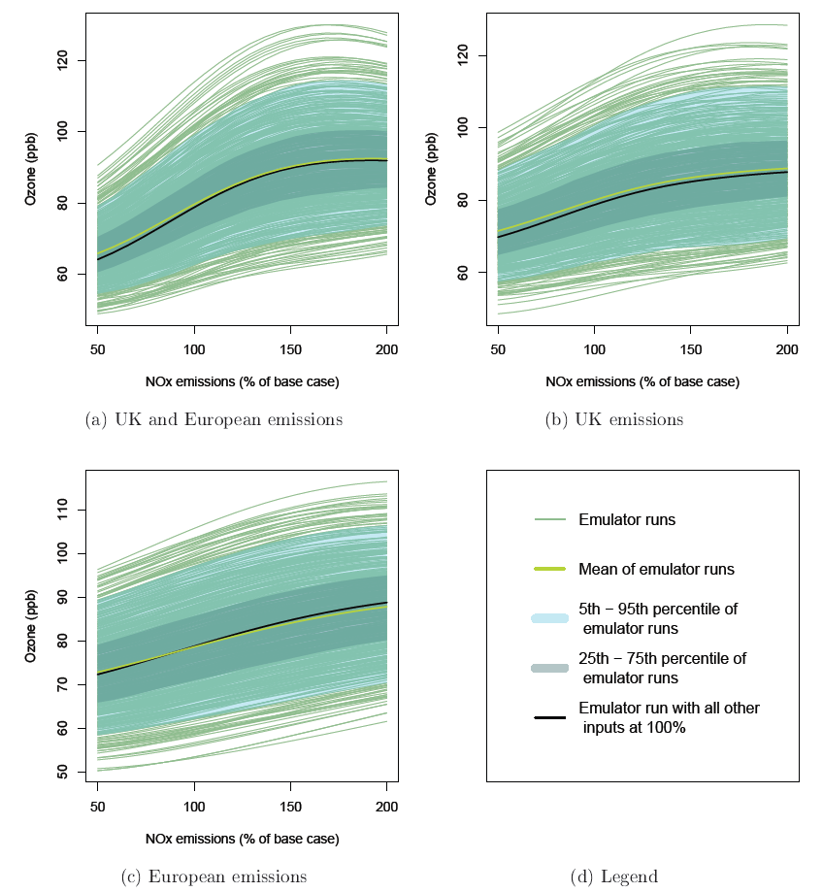
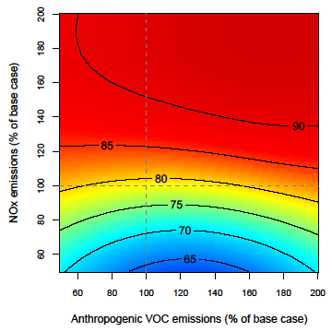
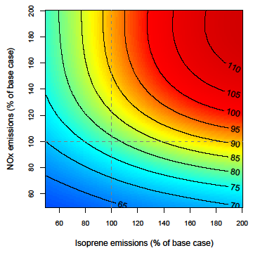
Examples of the emulator in use
- all produced with the same emulator
Notes:
Before I go on to talk about the sensitivity analyses, which are the main results I want to present, Id just like to show you a couple of other examples of different analyses done with one of the same emulators.
At the top we have an example of plotting the response of CMAQ ozone output to changes in NOx emissions, whilst also accounting for uncertainty in other inputs. The black line in the centre of the distribution is made by sampling ozone concentrations from the emulator across a range of NOx values while keeping all of the other inputs fixed at their baseline values. This is then repeated to produce each of the green lines, but this time the other inputs are set at values which have been randomly sampled from the distributions which describe the uncertainty we have in their baseline values.
Moving on to the plots in the bottom half of the slide, the effect of NOx emission changes on ozone output is shown again, but this time in conjunction with changes in VOC emissions. NOx against isoprene emissions, on the left, shows the sort of behaviour we’re used to seeing, with a ridgeline, albeit quite a gentle ridgeline, running diagonally across the plot, separating a NOx sensitive regime from a VOC sensitive regime. On the right we’ve swapped isoprene emissions for anthropogenic VOCs and here we see that ozone concentrations have very little sensitivity to anthropogenic VOCs at this location, with the bottom half of the plot being NOx sensitive, and the top half not being very sensitive to either NOx or VOCs.
The important point I want to make here is that once you’ve done your emulator training runs you don’t need to do any more CMAQ runs in order to perform a whole load of different analyses.

Slide 11
Global Sensitivity Analysis
Input factors are varied over their full ranges and are all varied independently from one another but at the same time, hence covering the entire input variable space.
In contrast to a local sensitivity analysis where input factors are varied by a small amount around their nominal values (e.g. DDM).
Sensitivity Indices:
Varying the inputs induces a variance in the model output which can be decomposed into a sum of terms of increasing dimensionality⁽⁴⁾:
Each of the variances in the first term in the series divided by the total variance gives the `main effect’ for a particular input.
Dividing the sum of all terms involving a particular input by the total variance gives the `total effect’ for that input i.e. the main effect plus interactions.
Notes:
Coming back to sensitivity analysis, I’m looking at performing a global sensitivity analysis, which is one in which the input factors are perturbed over their full ranges of variability, independently from one another but all at the same time, and in this way covering the whole input variable space.
This is in contrast to a local analysis which is one in which the inputs are varied by a small amount around their nominal values, and DDM sensitivity coefficients would be an example of this.
So, in order to measure the effect of varying all those inputs we need some kind of sensitivity indices, and one way of doing this is by a variance decomposition. Perturbing all of the inputs at once induces a variance in the model output, which can be decomposed into a sum of terms of increasing dimensionality.
Each of the terms in the sum can be divided by the total variance to give the fraction of the variability which is associated with that particular input or combination of inputs. So if we divide one of the variances in the sum in the first term by the total variance we get what we call the main effect for that particular input, and dividing all of the terms involving a particular input by the total variance gives the total effect for that input, which is the main effect plus the effect of interactions with other variables.

Slide 12
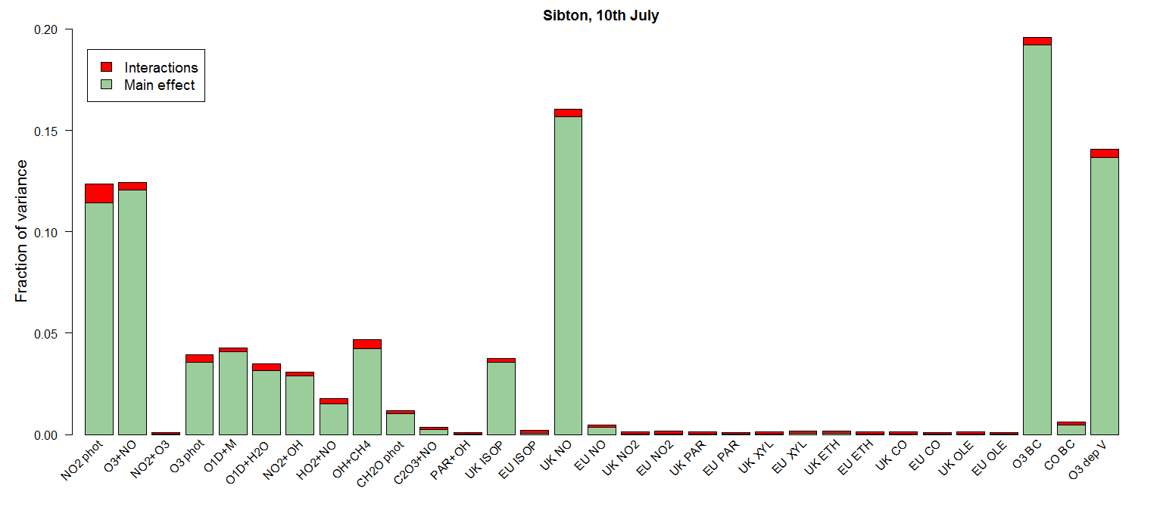
The sensitivity indices involve high dimensional integrals which are difficult to calculate directly but can be estimated using a number of methods.
The most efficient of these methods is the Fourier Amplitude Sensitivity Test (FAST)⁽⁵⁾.
Each input is perturbed at a different frequency giving a set of superimposed periodic signals in the model output which are then detangled using Fourier analysis.
The heights of the bars show the reduction in variance which would be achieved if the correct value of that input were known and could be fixed, both as an individual effect and in its interactions with other variables.
Notes:
Calculating those sensitivity indices directly involves solving some high dimensional integrals, which is difficult to do directly, but they can be estimated in a number of ways.
The most efficient of these is the Fourier Amplitude Sensitivity Test or FAST for short, in which each of the input variables is perturbed at a different frequency, producing a set of superimposed periodic signals in the model output, which can then be disentangled using Fourier analysis to find which signal is attributable to which input, and then the relative amplitudes of those signals correspond to the relative importance of each of the inputs.
The graph shows the output of this kind of analysis, with the green sections of the bars showing the main effects as a fraction of the total model output variance. The red portions represent the interactions, so together they add up to the total effect for each input.
As another way to think about these sensitivity indices, the heights of the bars show the reduction in variance which would be achieved if that variable were fixed and all the others were allowed to continue to vary.

Slide 13
For the July 2006 UK pollution episode ...
Variable | Distribution
R1: NO2 photolysis | normal, sd = 0.2
R3: O3 + NO | normal, sd = 0.1
R7: NO2 + O3 | normal, sd = 0.15
R9: O3 photolysis | normal, sd = 0.3
R10: O1D + M | normal, sd = 0.5
R11: O1D + H2O | normal, sd = 0.08
R28: NO2 + OH | normal, sd = 0.4
R30: HO2 + NO | normal, sd = 0.3
R66: OH + CH4 | normal, sd = 0.1
R74: CH2O photolysis | normal, sd = 0.4
R87: C2O3 + NO | normal, sd = 0.5
R112: PAR + OH | normal, sd = 0.3
NO emissions | uniform, ± 0.3
NO2 emissions | uniform, ± 0.3
ISOP emissions | uniform, ± 0.3
PAR emissions | uniform, ± 0.3
XYL emissions | uniform, ± 0.3
ETH emissions | uniform, ± 0.3
CO emissions | uniform, ± 0.3
OLE emissions | uniform, ± 0.3
O3 boundary conditions | uniform, ± 0.3
CO boundary conditions | uniform, ± 0.3
O3 deposition velocity | uniform, ± 0.3
576 1 month CMAQ runs were made, each with different values of the 31 input variables retained after the screening process.
These values were selected according to a 31 dimensional Latin hypercube design.
After a 10 day spin up FAST was performed for each hourly time step of the 21 day period from 11th to 31st July, for various locations around the UK.
Notes:
OK, so coming back to the July 2006 pollution episode over the UK. I’ve made 576 1 month CMAQ runs each with different values of the 31 input variables which were retained after the screening process, and those values were selected according to a 31 dimensional Latin hypercube design.
So, if you remember, the Latin hypercube covers the ranges of each variable evenly in order to build the emulator, but in order to perform the FAST sensitivity analysis we need probability distributions representing the uncertainty in the baseline values of each of the inputs. I’m performing the sensitivity analysis within an uncertainty analysis context, so its the sensitivity to input variable uncertainty that I want to calculate.
The table shows the distributions that I’ve used, they come from various literature sources, such as the NASA JPL chemical kinetics tables and documents on uncertainty in the UK national atmospheric emissions inventory. They are all centred on a value of one, so that sampling from them gives a factor by which I can multiply that particular input. The emissions are perturbed for my inner model domain covering the UK, and separately for the the outer domain which covers most of Europe.
I’ve used a 10 day spin up to make sure I didn’t have to include initial conditions in the analysis, and then I’ve performed the FAST for each hourly time step of the 21 day period from the 11th to the 31st of July for various locations around the UK.

Slide 14
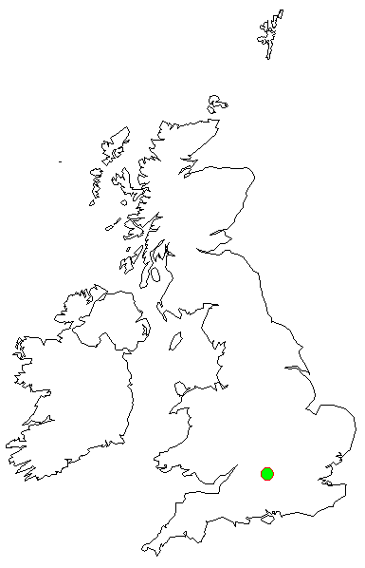
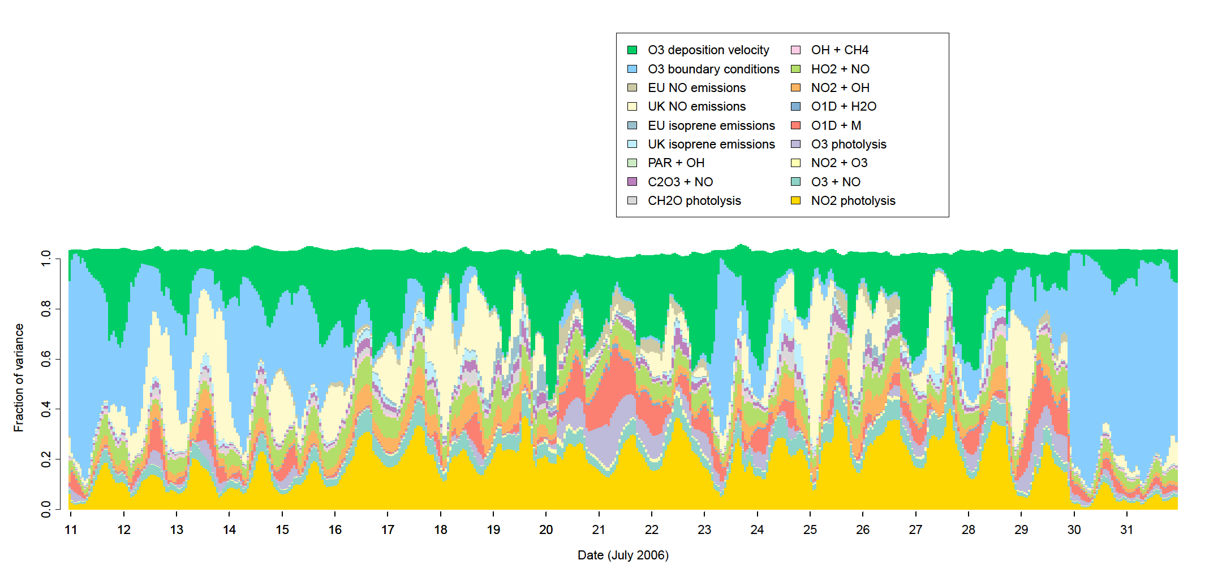
Harwell, July 2006
Notes:
So if I plot the total effects as stacked bars at each time step this is the sort of thing we get. This is for a place called Harwell in central southern England, which we class as a rural background location, but in this part of the UK you’re never very far from major roads, so some of you might think of this as semi-rural or semi-urban with respect to your own model domains. There’s obviously a lot of detail in here which we won’t be able to consider just looking at it for a couple of minutes on this slide, but there’s a couple of things you might have noticed straight away.
The first is the number of variables, which incidentally are shown in the legend from top left to bottom right in the same order as on the plot, - there’s only 18 variables here, not 31, and that’s because I’ve only included those which accounted for more than 1% of the variance at any time step. This is reassuring because it shows that the threshold for retaining variables wasn’t set too high during the screening process.
The second thing is that the fraction of variance adds up to more than one, which might seem odd, but I’ll come back to that on the next slide.
I’ll just point out some of the major features, and one is the influence of ozone boundary conditions, shown in blue, which were much more influential at the start and end of the period when winds were stronger. The highest ozone concentrations occurred around the 18th and 19th and from the 24th to the 27th when boundary conditions are less important and uncertainties in reaction rates and NO emissions become more important with respect to total model output uncertainty.

Slide 15
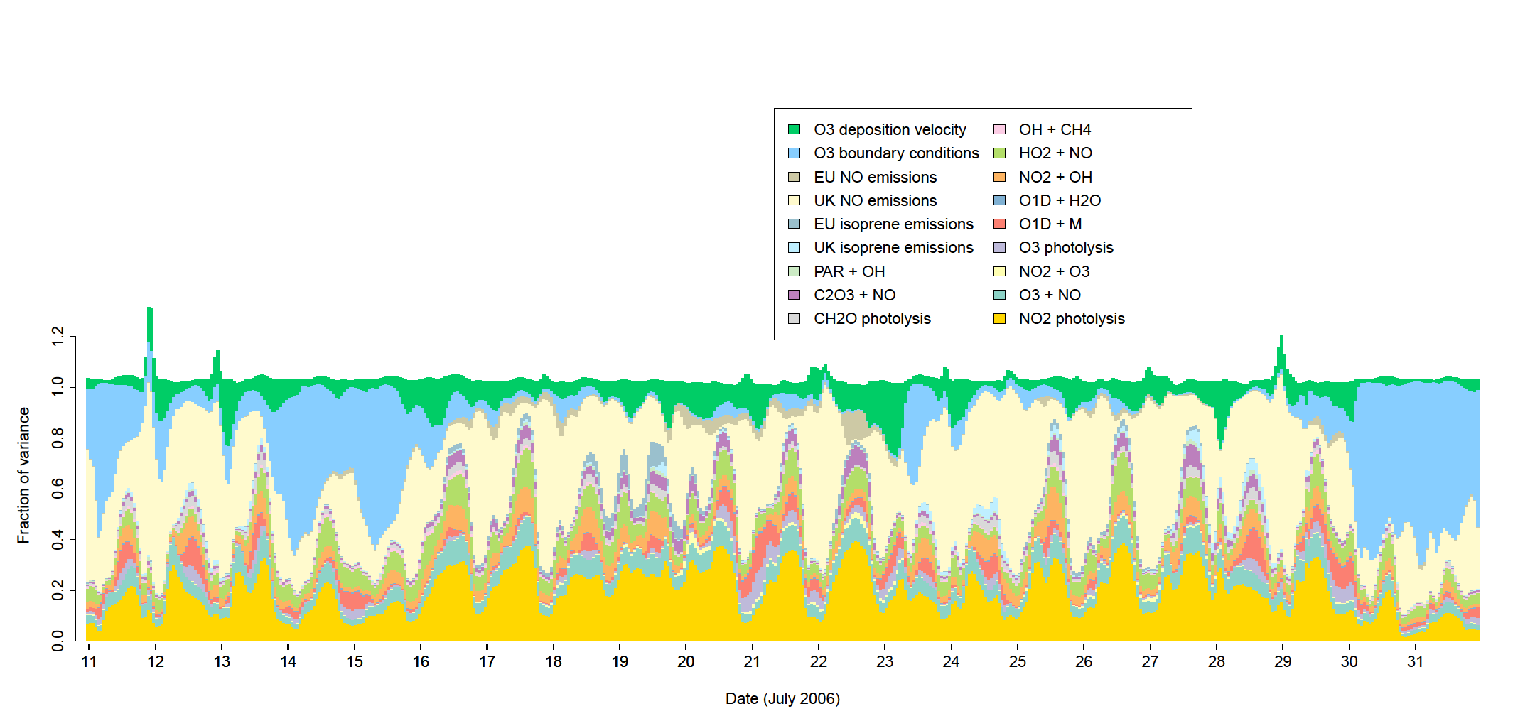
London, urban background, July 2006
The total fraction of variance adds up to more than one because of the interaction effects – spikes in the top line of the graph indicate times when interactions between input uncertainties were particularly important
Notes:
I’m just going to show one more of these plots, because as I said at the start of the talk, they’re very specific to the particular time and place and really serve to demonstrate they kind of detailed results you can produce with these methods.
This one is for London, and as the grid cell size was 9km its best described as urban background, in comparison to Harwell, uncertainty in NO emissions are much more important, reflecting the fact that those emissions are very high in this kind of environment.
To talk about why the fraction of variance adds up to more than one, we need to remember that its the total effects were plotting, and that includes all of the interactions for each variable, so, for example the interactions for NO emissions include the interaction with ozone deposition velocity, and the interactions for ozone deposition velocity include the interaction with NO emissions. This means that the top line of the graph indicates the total amount of interaction between variables. spikes in this top line indicate times when interactions between input uncertainties were particularly important.
Interestingly, the spikes on this graph all occur shortly before midnight, so I’ve plotted out one of those time steps separately.

Slide 16
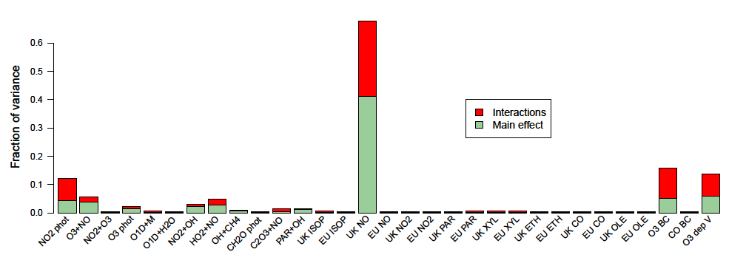
London, urban background, 10 pm, 11th July 2006
Notes:
This is the largest of those spikes, which was at 10 pm on the 11th , and we can see that there was a large degree of interaction between NO emissions and a few other variables.
Given that this is midsummer, and the sun won’t have been down for long, we can probably say that there is a large degree of interaction between input uncertainties in an urban environment during the transition from daytime to night time chemistry, but we would have to study this time step in further detail to say anything more.

Slide 17
Conclusions
Emulators allow much more rigorous analyses of complex models to be carried out.
Such analyses would not be possible using CMAQ directly because of long model run times.
Meteorological inputs have not been considered yet – these have yet to be added to the analysis.
Gaussian process emulation, FAST and screening with Morris’ method can all be carried out using user contributed R packages - full references for these will be given in the extended abstract.
PhD project funded by the MRC-PHE Centre for Environment and Health.
Notes:
I’m going to move to the conclusions now, and I’ll keep it quite brief by just saying that Gaussian process emulation allows much more rigorous analysis of complex models to be carried out than would be possible by simply running the model directly, and this is generally because of the long run times that models like CMAQ tend to have.
There is an elephant in the room, and that’s that I haven’t talked about any meteorological inputs, I still have to add these to the analysis.

Slide 18
References
Morris, M. D. Factorial Sampling Plans for Preliminary Computational Experiments. Technometrics 1991, 33 (2), 161–174.
McKay, M.; Beckman, R.; Conover, W. A comparison of three methods for selecting values of input variables in the analysis of output from a computer code. Technometrics 1979, 21 (2), 239–245.
Oakley, J.; O’Hagan, A. Bayesian inference for the uncertainty distribution of computer model outputs. Biometrika 2002, 89 (4), 769–784.
Sobol’, I. M. On sensitivity estimation for nonlinear mathematical models. Matematicheskoe Modelirovanie 1990, 2 (1), 112–118.
(5) Cukier, R. I.; Levine, H. B.; Shuler, K. E. Nonlinear sensitivity analysis of multiparameter model systems. J. Comput. Phys. 1978, 26, 1–42.

